Slide 1
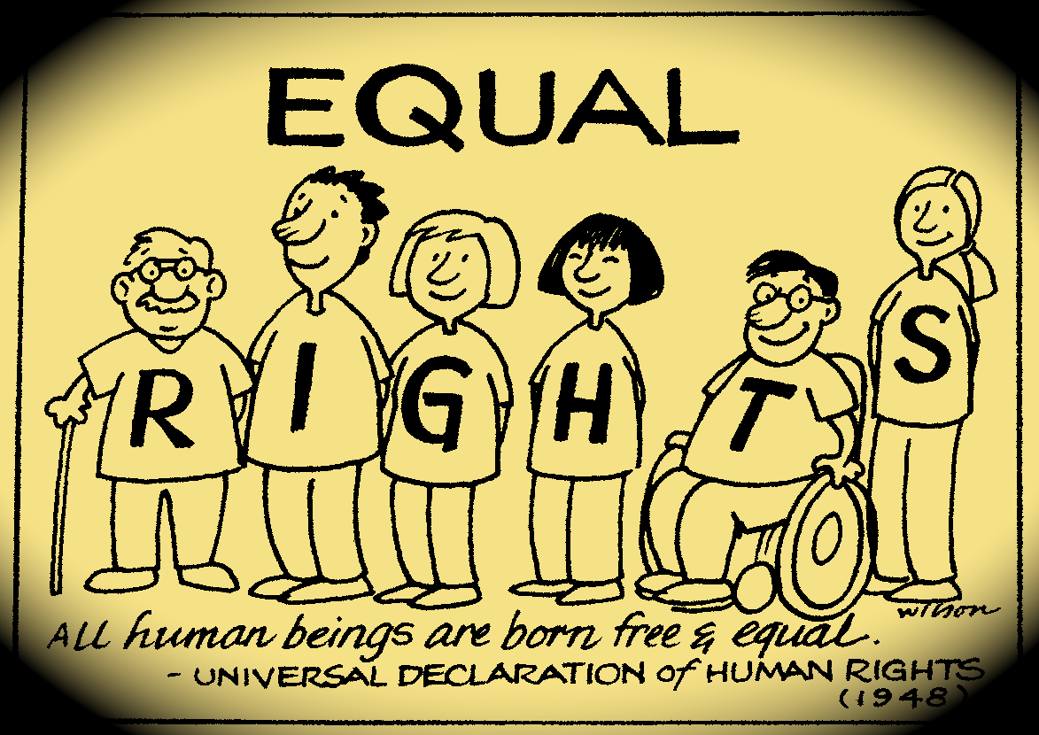
Democracy in Action Rights we have

Slide 3
Rights
Something that is claimed by almost all people and recognized by almost all people as or quality of human beings that imposes a passive or negative obligation on other human beings.
are of essential importance in such disciplines as law and ethics.
are legal, social, or ethical principles of freedom or entitlement.
A freedom that is protected.
Can be defended in a court of law

Slide 4
Canadian Charter of Rights and Freedoms
Meet peacefully with others
Follow any religion we choose
The Charter protects our Freedoms to
Give our opinions in media and newspapers
Think and believe what we like
Say what we think

Slide 5
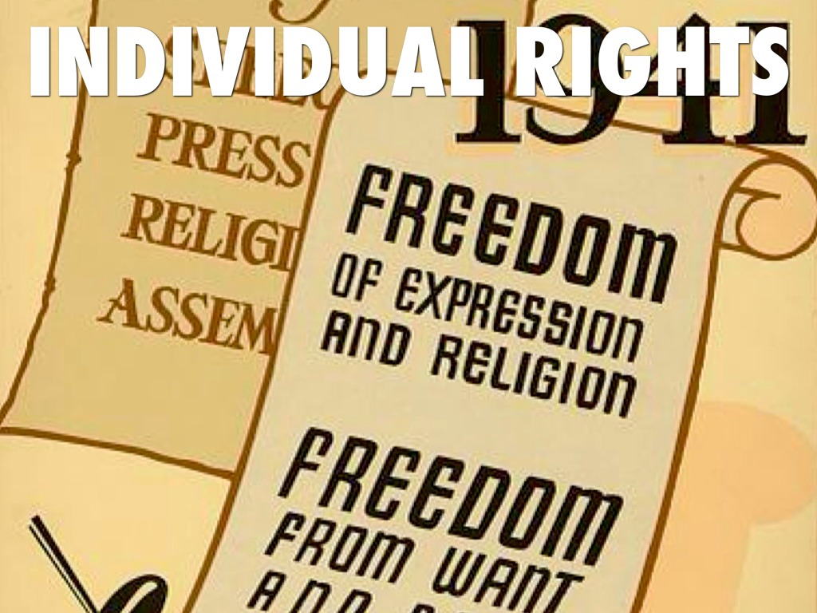
Individual rights
Rights that you are entitled to as a person.
Government is to identify and protect these rights.
Guarantees and individuals to certain freedoms without interference from the government of other people.
What are some of our individual rights?
The Charter can limit our rights and freedoms. What limits might there be to freedoms? Why might rights be limited?

Slide 6
Statements from the Charter.
Everyone has the right to life, liberty and security of the person and the right not to be deprived thereof except in accordance with the principles of fundamental justice."
"Every citizen of Canada has the right to vote in an election of members of the House of Commons or of a legislative assembly and to be qualified for membership therein."
"Everyone has the following fundamental freedoms:
(a) freedom of conscience and religion;
(b) freedom of thought, belief, opinion and expression, including freedom of press and other media of communication;
(c) freedom of peaceful assembly; and,
(d) freedom of association.“
Every citizen of Canada has the right to enter, remain in, and leave, Canada.
Every citizen of Canada and every person who has the status of a permanent resident of Canada has the right:
to move to, and take up residence in, any province, and
to pursue the gaining of a livelihood in any province.

Slide 7
Collective rights
Rights that are given to a certain group- for example Aboriginal people and Anglophones and Francophones.
Individuals who are part of said group are entitled to collective rights.
Aboriginal people have certain rights as original occupants of Canada.
The charter recognises the rights of both English and French communities because of the unique role each played on founding Canada.

Slide 8
Statements from the Charter of Rights and Freedoms
English and French are the official languages of Canada and have equality of status and equal rights and privileges as to their use in all institutions of the Parliament and Government of Canada.
The guarantee in this Charter of certain rights and freedoms shall not be construed so as to abrogate or derogate from any Aboriginal, treaty or other rights or freedoms that pertain to the Aboriginal peoples of Canada including
any rights or freedoms that have been recognized by the Royal Proclamation of October 7, 1763; and
any rights or freedoms that now exist by way of land claims agreements or may be so acquired.

Slide 9
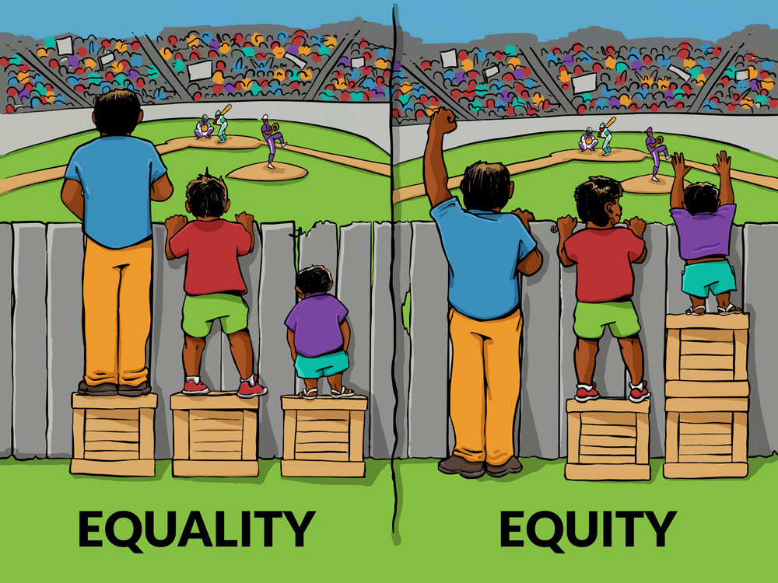
Equality vs Equity

Slide 10
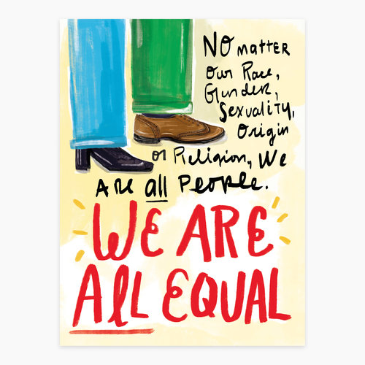
Equality rights
Equality- each individual treated equally with dignity, respect regardless of a person’s race, religion, gender, age, disability,etc.
Treating people equally means providing each individual or group with respect and equal opportunity.
Treating people or groups with special needs equally means accommodating their disabilities.

Slide 11
Statements from the Charter of Rights and Freedoms
"Every individual is equal before and under the law and has the right to the equal protection and equal benefit of the law without discrimination and, in particular, without discrimination based on race, national or ethnic origin, colour, religion, sex, age or mental or physical disability.“
Subsection (1) does not preclude any law, program or activity that has as its object the amelioration of conditions of disadvantaged individuals or groups including those that are disadvantaged because of race, national or ethnic origin, colour, religion, sex, age or mental or physical disability. (Affirmative action programs)

