Slide 1
Democracy in action Democratic rights!

Slide 2
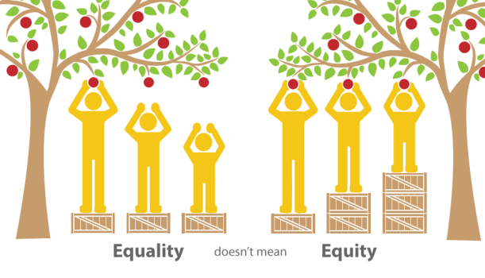

Slide 3
Consider the following statements:
Only some citizens should be allowed to vote.
Only citizens born in the country are allowed to run for parliament.
An elected government can decide it will stay in power for 20 years without an election.
A government is elected but years go by without it meeting or without it passing any laws.
Should these be allowed in a democracy? Why or why not?

Slide 4
Democratic rights
Every citizen of Canada has the right to vote for representatives in an election and has the right run for office.
Democratic rights also set guidelines for the Government:
No Government shall be in power for longer than 5 years without an election, except in severe circumstances.
Provincial and Federal governments must meet at least once every 12 months.

Slide 5
Representative democracy
What is a representative democracy?
In a representative democracy citizens elect people to represent them in government. These people make decisions on behalf of the citizens.
These representatives have the responsibility to listen to the needs of all citizens.
How might we participate in a representative democracy?

Slide 6
The right to vote
Originally only men from Europe who owned property were allowed to vote in Canada.
Woman’s Suffrage movement
Women fighting for the right to participate in Government and the right to vote.
By 1918 some women of Canada given the right to vote. Others had to wait longer, 50 years, due to religion, background, country of origin.
This movement was the gateway to Women’s rights and diversity in Women’s education.

Slide 8
Rule of Law
Magna Carta- a document created in 1215 introduced the idea of the rule of law. Our charter is based off this document. Protects the rights of an arrested person.
Rule of law- means everyone must obey the law and no one is above the law. Laws apply equally to everyone.
Under the rule of law:
Citizens have a say in changing the law.
People are informed about the law.
All people are treated equally.
People participate in applying the law; Jury duty.

Slide 9
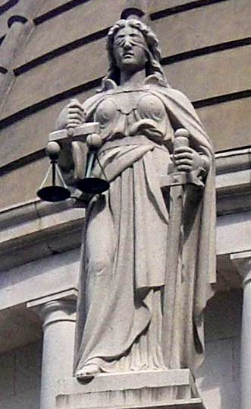
Lady Justice

