Slide 1
Democracy in Action! Put your freedom to the test!!!!

Slide 2
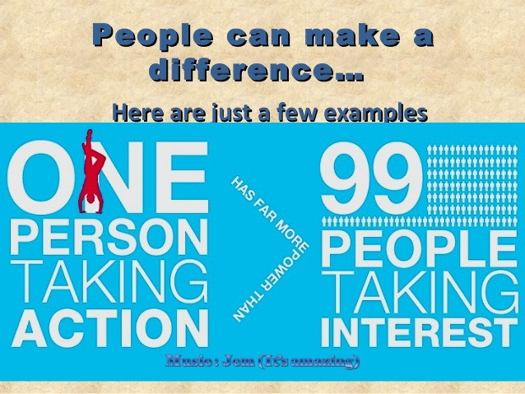
How can we participate in our Community?

Slide 3
Steps to identify injustice
Step 1:Researching
Choose a situation of injustice that is affecting the well-being of your local community.
-Step 2: Critically evaluating the problem
-Why might this be happening?
-Why is it important to correct this injustice?
Who or what is being affected?

Slide 4
Steps to identify injustice
Step 3: Critically evaluating organizations
Find out what organization(s) are trying to correct the problem. Evaluate what the organization(s) are doing.
Step 4: Participating
Select an organization to support and determine how you could best assist in correcting the injustice.

Slide 5
Local issues in Edmonton
Disability issues- https://globalnews.ca/news/3776953/west-edmonton-mall-wheelchair-lockdown/
An Edmonton woman was trapped in the Mall after a lockdown due to her wheelchair being unable to fit in the safe areas.
Isolation in communities-http://edmontonjournal.com/news/local-news/one-in-five-edmontonians-feels-social-isolation-from-community-report
1 in 5 people in Edmonton report that they feel isolated from their communities

Slide 6
Local issues in Edmonton
Homelessness-http://www.cbc.ca/news/canada/edmonton/edmonton-election-ward-6-homeless-downtown-social-housing-1.4306106
Tackling homelessness in downto
wn Edmonton.
Hunger problem- https://globalnews.ca/news/1903255/going-hungry-why-millions-of-canadians-cant-afford-healthy-food
Pay the rent or put food on the table?

