Slide 1
Paper Airplanes
Scientific Method

Slide 2
Scientific inquiry
Scientific Inquiry refers to the many different ways in which scientists investigate the world. Scientific investigations are done to answer questions and solve problems. Many times investigations are said to follow a Scientific Method (as followed in our notes)

Slide 3
Part 1: Identify and State the Question or Problem.
You want to know which paper airplane design is best.
The first thing you have to do is decide what best means.
This is called an operational definition – the definition you will use during the investigation. For this investigation, we will define best as the plane that flies the farthest.

Slide 4
You will be completing this scientific method with a partner (no groups of 3) or individually
You will need to decide with your partner what you want to test
Then you will need to come up with your problem

Slide 5
Hypothesis
State a hypothesis. Based on how we defined best and what you now know about paper airplanes, write a hypothesis that states which type of paper airplane (that you are testing) will fly the greatest distance and why you think this. Use complete sentences.

Slide 6
Writing your Procedure
When you design an experiment, you must first pick one thing to test:
the length of the plane, the weight of the plane, the style of the plane, position of weights on the plane, and so on. This is called the Manipulated or Independent Variable – it is what you, the scientist will change or test.
Everything else that could possibly change, but doesn’t is called a Controlled Variable. Scientists control all the variables they can so that they can be sure that the results of the investigation are due to the change in the one variable that is tested.
You must decide what kind of data you will collect or what you will observe and measure. This is called the Responding or Dependent Variable.
You need to repeat the experiment several times. These are called Trials. Multiple trials help make sure that your data in consistent. If you only do an experiment one time, you might get some very unusual data for many reasons. Repeating the experiment allows you to be confident in your findings.
A list of Materials is needed so that other scientists can repeat your experiment.

Slide 7
This is an example of what your procedure might look like. Add any extra steps needed for your investigation.
1. Select 3 different paper airplanes. a. __________________________________
b. __________________________________
c. __________________________________
2. Pick a spot to launch the planes each time. 3. Throw the first airplane and measure the distance it flies. Record the data. Repeat 4 more times. 4. Throw the second airplane and measure the distance it flies. Record the data. Repeat 4 more times. 5. Throw the third airplane and measure the distance it flies. Record the data. Repeat 4 more times.

Slide 8
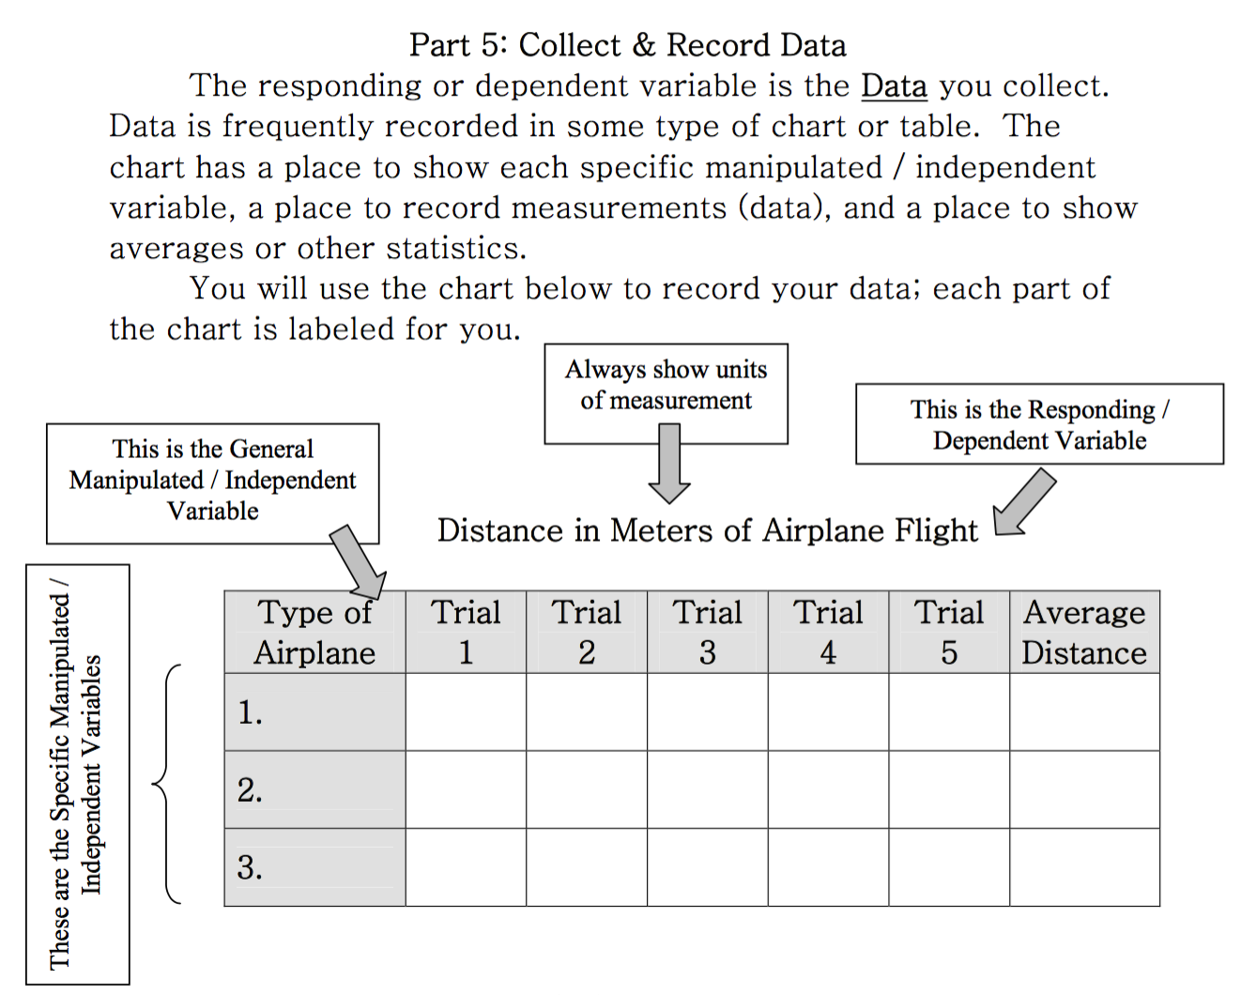

Slide 9
Make your Conclusion
A conclusion is a discussion of the data. The data is described and explained and the hypothesis is accepted or rejected. A hypothesis is never “right” or “wrong” – it is either supported by the data or it is not supported by the data.
The conclusion also discusses the usefulness of the results (why was the investigation practical?), how the investigation can be improved, and other questions raised during the investigation.

Slide 10
Now you are ready to begin!!!
You will be using the website(s) http://funpaperairplanes.com/plane_downloads.html or http://www.amazingpaperairplanes.com/Simple.html
to help you choose your airplane design (make sure to read the flying tips)
After you have created your Scientific Method with your partner or on your own, you are ready to begin
You and your partner will be responsible to each hand in a ’Final Copy’ of your scientific method – either typed up or written neatly
Have fun and begin!

