Slide 1
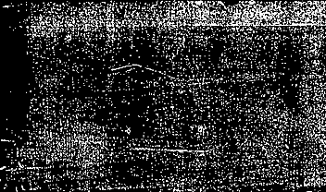
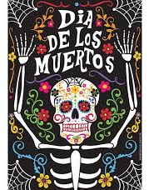

Dia de Los Muertos
Day of the dead

Slide 2
Day of the Dead – November 2
Day of the Dead is a Mexican holiday celebrated on November 2nd. The holiday focuses on the gathering of family and friends to pray for and remember loved ones who have died, and help support their spiritual journey. In Mexico, Dia de Los Muertos is a National holiday.
Families build private altars honoring the deceased and decorate with sugar skulls, Catrina dolls and marigolds

Slide 3
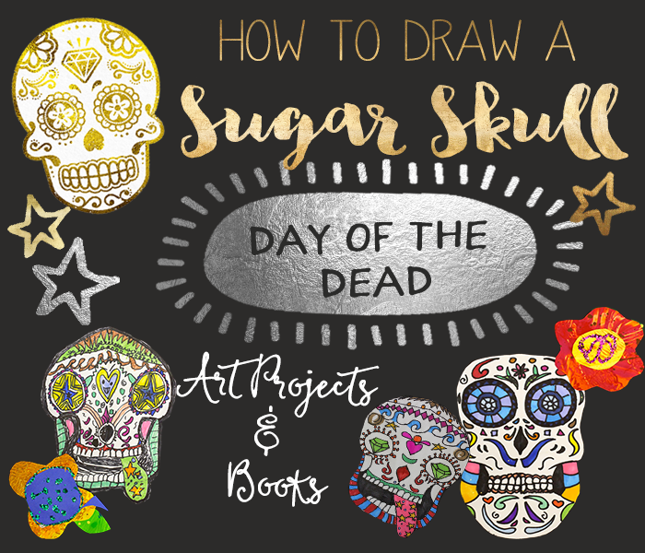

Slide 4

Sugar skulls
What do you notice about the skulls?
What stands out to you?

Slide 5
Symmetry
What is symmetry?
The simplest symmetry is Reflection Symmetry (sometimes called Line Symmetry or Mirror Symmetry)
It is easy to see, because one half is the reflection of the other half

Slide 6
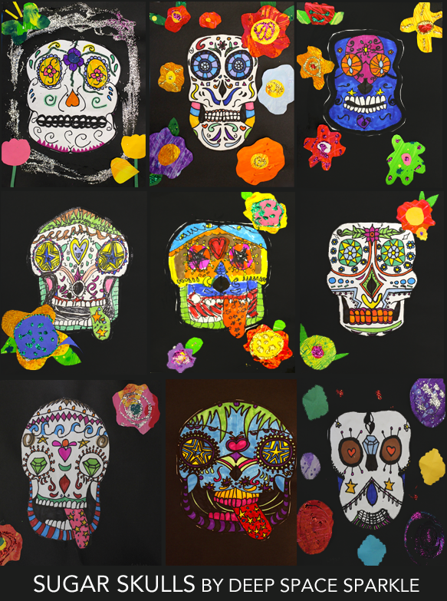
Marigolds
Marigolds guide the spirits to their altars using their vibrant colors and scent.
Marigolds, or flowers in general, also represent the fragility of life.
The marigold most commonly used in Dia de los Muertos celebrations
You may cut out, create marigolds to include on your Sugar Skull if you choose

Slide 7
What next? Steps:
Draw your Skull shape on a large piece of white paper in pencil and then go over with sharpie – remember your want your skull to be symmetrical
Draw in your eye shapes, nose shape and mouth shape
Decorate your skull with vibrant colors, designs & symbols. Remember this art project is all about SYMMETRY!
Cute out your skull and glue it on a black piece of paper
Cut out or draw marigold flowers to add to your project

Slide 8
