Slide 1
Deciduous or Coniferous?

Slide 2
Types of Trees
Deciduous | Coniferous
- Loses leaves in the fall | - Shed continuously
- Broad shaped or needle shaped | - Needle shaped leaves
- Leaves waxy topside and large surface area on underside causing moisture loss | Thick waxy coating reduces water loss from transpiration
- Do not withstand temperature extremes | Do withstand temperature extremes
 | Cone bearing

Slide 3
Coniferous & Deciduous
*A larch (tamarack) is both deciduous and coniferous
It loses its leaves in the fall and is also cone bearing

Slide 4
Leaf Classification
Gr. 6 Science

Slide 5
Leaves are the most common feature used for identifying a tree. Leaves come in many different shapes, colours, and sizes.

Slide 6
Parts of a Leaf
Each leaf has certain parts: a petiole, a lamina (or blade), veins, a midrib, and margins. Each part of a leaf has a certain function, or job.

Slide 7
The Petiole
The petiole is the part of the leaf that is attached to the stem.
Also known as the stalk.
May be short or long in length.
Narrow and tube shaped.
The petiole supports the main body of the leaf, which is known as the lamina or blade. Besides holding up the leaf, the petiole also works as a passageway for nutrients and water. Petioles also help hold leaves so that they receive the most sunlight.

Slide 8
The Blade
The blade of the leaf is the body of the leaf.
It is sometimes called the lamina.
It is attached to the stem of a plant by the petiole.
The blade varies from plant to plant. Blades are usually green, thin, and flat in shape. However, blades can come in other colours and thicknesses. Leaf blades can be smooth, fuzzy, shiny, or dull. They also come in many different shapes.

Slide 9
Veins
Veins, midribs, and margins are found on the blade of a leaf.
Veins are the small visible lines on the leaf.
The veins help move water and nutrients to the blade.
Veins also support the blade and help maintain its shape. The midrib is found running through the middle of the leaf. It is the largest and most visible vein. It is also connected to the petiole. Like the veins, the midrib is used to pass on water and nutrients to the blade.

Slide 10
Margins
The edges of the blade are called margins.
These edges can be smooth, jagged, toothed, or wavy.
Margins are used to define the shape of the leaf.

Slide 11
Leaf Classification
Scientists have classified leaves based on their characteristics. The shape of a leaf, the kind of leaf margin, and veining can all be used to classify and identify trees. The leaf type and the arrangement of leaves on the twig are also important factors in tree identification.

Slide 12
Leaves can be classified based on the shape of the blade. There are 10 different leaf shapes: linear, oblong, oval, ovate, cordate (heart-shaped), lobed, deltoid (triangular), orbicular (round), four-sided needles, and flat needles.

Slide 13
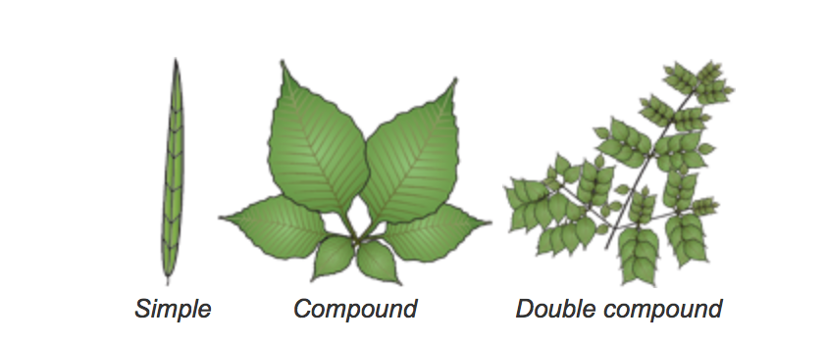
Another way to classify leaves is by leaf type.
Simple leaf type - only one leaf on each petiole
Compound type - more than one blade on each petiole. Leaves can also be Double compound - several blades attached to several petioles.

Slide 14
Leaves can also be classified by their arrangement on a twig.
Leaf arrangements can be opposite, alternate, whorl, and basal.
Needle arrangements can be in bundles of two and five, singly on a twig, or scale-like and in clusters of more than five.

